Slide 1
CSC6032 – Advanced Operating Systems
Agent OS
Prof. Yeh-Ching Chung
School of Data Science
Chinese University of Hong Kong, Shenzhen

Slide 2
Agenda
Introduction
Agent OS
Agents
Agent paradigm
Life cycle of an agent
Agent OS requirements
Design of agent OS
Advantages
Conclusion

Slide 3
Introduction
Internet - world wide information repository
Resource sharing on a world wide basis
Agents are new approach to the development of distribute client-server application

Slide 4
Agent OS
Supports agent-based client-server applications
Behaves as a traditional server for a single host
Entire network-provides an environment for distributed applications

Slide 5
Agents
Supports agent-based client-server applications
Object representation of distributed systems
Contains both computational logic and state information
It can be a single algorithm or a complete application
Agents are active and mobile

Slide 6
Agent Paradigm (1)
Classical architecture involves two parts
  Lower Level layer-Implementing communication protocol
  Higher Level layer-Implementing algorithm
Drawbacks
  The complexity of the lower layer
  Separation between these layers may not be clear

Slide 7
Agent Paradigm (2)
Provide solution to above problems
Distributed application is broken down into components − Agents
Agents are then used to carry out the algorithms
Agents behaves more like a centralized application
Agent OS is responsible
  Transporting agents
  Communication between agent hosts

Slide 8
Agent Paradigm (3)
Provide solution to above problems
  Separation b/w communication protocol layer & application layer
  Changes in applications are localized to the application layer
  Changes in communication protocol do not have an effect on application

Slide 9
Agent Paradigm (4)
Applications suited for mobile agents
  Distributed Data Collection
  Monitoring
  Information Delivery and ‘Push’ Negotiation
  Transaction
  Parallel Processing

Slide 10
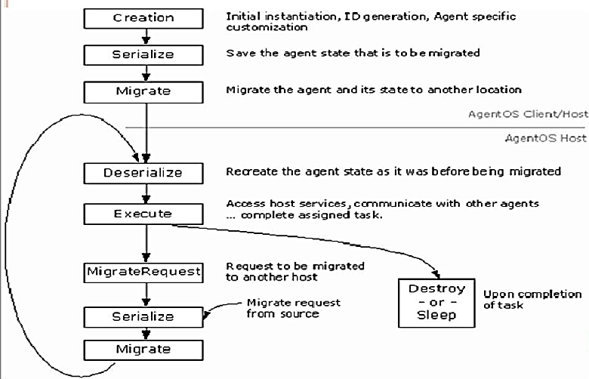
The Agent Lifecycle

Slide 11
Agent OS Requirements
Platform independence
Dynamic agent invocation
Migration of agents and their state
Inter-agent communication
Agent reuse
Unique naming scheme
Security
Feature-rich

Slide 12
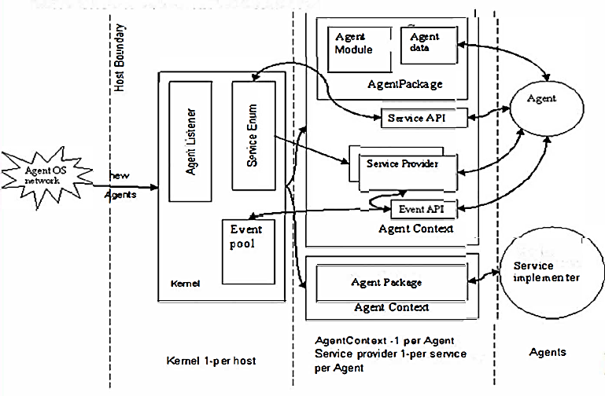
Architecture of Agent OS

Slide 13
System Components of Agent OS (1)
Kernel
  Provides access to system services
  Monitoring n/w connection Implement communication protocol
Service Enum
  Part of kernel subsystem
  Manages a list of standard and extended services

Slide 14
System Components of Agent OS (2)
Event Pool
    Each AgentOS s/m contains a single event pool
    Provides queue based communication b/w agents
Agent Context
    Provides execution model for agents
    Starts, stops and controls the execution of agents

Slide 15
System Components of Agent OS (3)
Agent
    Implements computational logic
Agent Package
    Used in migration of the agent
    Contains agents & resources needed to execute agents
Service Providers and Service Implementers
    Service provider - API for agent to access services
    Service implementer − implements actual service

Slide 16
Instance IDs
AgentOS ID
    Static ID
    Combination of n/w address, time stamp and a sequential Counter
    Guarantees uniqueness to static objects
Agent Instance ID
    Guarantees uniqueness to static & active objects
    Combination of n/w address and time of creation

Slide 17
Instance IDs
AgentOS ID
    Static ID
    Combination of n/w address, time stamp and a sequential Counter
    Guarantees uniqueness to static objects
Agent Instance ID
    Guarantees uniqueness to static & active objects
    Combination of n/w address and time of creation

Slide 18
Advantages
Load balancing & Fault tolerance
Disconnected operation
Reduced Inter-node communication
Event based communication Secure transaction

Slide 19
Conclusions
AgentOS is an OS “of agents, for agents, and by agents”
System functions are carried out by agents, hence an OS of agent
Agent OS manages the agents,hence OS for agents
For agent communication underlying protocol is partially generated by agents

Slide 20
Q & A

